Slide 1

U-NET FOR DRIVEWAY SEGMENTATION
Presented by :
Swostika Basukala

Slide 2
PRESENTATION OUTLINE:
INTRODUCTION TO THE UNET MODEL
ARCHITECTURE OF UNET
IMPLEMENTATION FOR DRIVEWAY SEGMENTATION
COMPARISON BETWEEN THE UNET AND IMPLEMENTED ARCITECTURE
RESULT AND ANALYSIS
REFERENCES

Slide 3
INTRODUCTION TO UNET MODEL
Deep learning model specifically designed for biomedical image segmentation tasks.
Created in 2015 by researchers from the University of
Freiburg in Germany
Primary purpose of this was to address the challenge of limited annotated data in the medical field.
consists of a contracting path and an expansive path.
Implemented for diverse datasets like carvana dataset, biomedical images and satellite images for image segmentation

Slide 4

ARCHITECTURE OF UNET MODEL

Slide 5
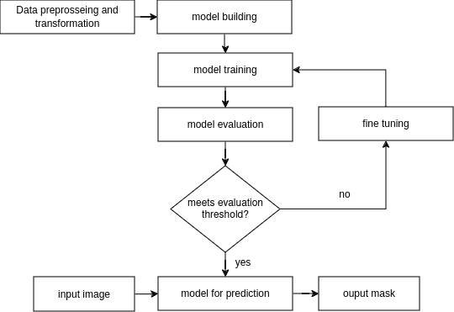
IMPLEMENTATION
fig: workflow

Slide 6
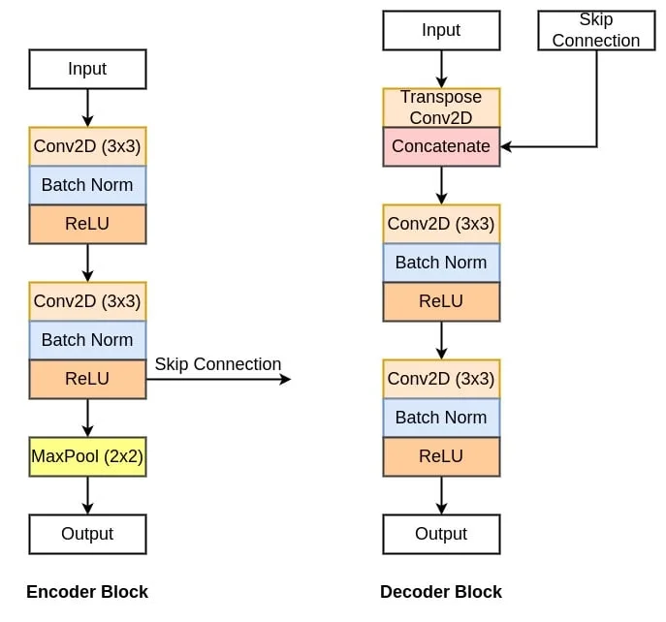
IMPLEMENTATION

Slide 7
COMPARISON OF IMPLEMENTED AND ORIGINAL MODEL
Firstly, cropping is not taken into consideration while concatenating the feature maps from contracting and expanding paths.
Secondly, padding is used in the contracting path. This will make the output feature map the same size as the input image. This is important because most of the modern semantic segmentation architectures follow this rule.
Third we have used batch normalization after each 2d convolution layer

Slide 8
MODEL SUMMARY
Total params: 31,037,633
Trainable params: 31,037,633
Non-trainable params: 0
Input size (MB): 3.00
Forward/backward pass size (MB): 3718.00
Params size (MB): 118.40
Estimated Total Size (MB): 3839.40
Optimizer: Adam optimizer
Loss function: Binary cross entropy with logits

Slide 9
HYPER-PARAMETERS
LEARNING_RATE = 3e-4
BATCH_SIZE = 16
NUM_EPOCHS = 10
IMAGE_HEIGHT = 512
IMAGE_WIDTH = 512
OPTIMIZER=ADAM

Slide 10
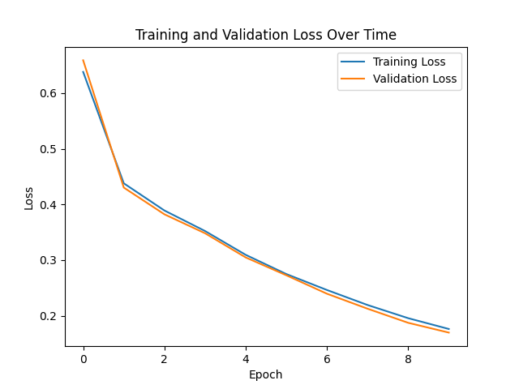

RESULT AND ANALYSIS

Slide 11
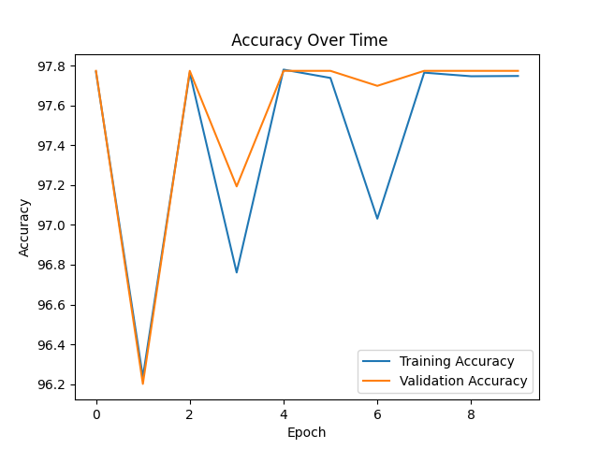
RESULT AND ANALYSIS

Slide 12
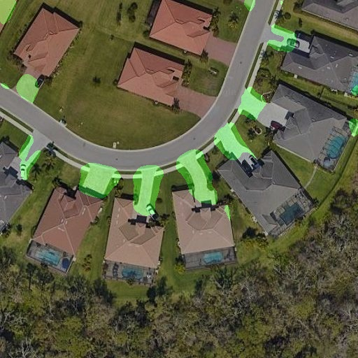
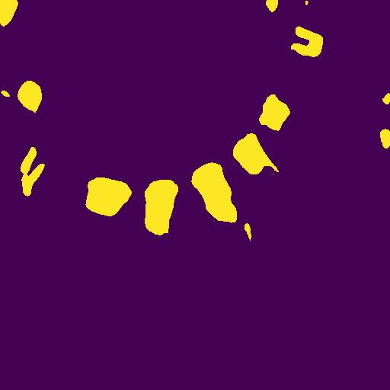
RESULT AND ANALYSIS
Overlay-ed image
Predicted mask (eroding(8X8))

Slide 13
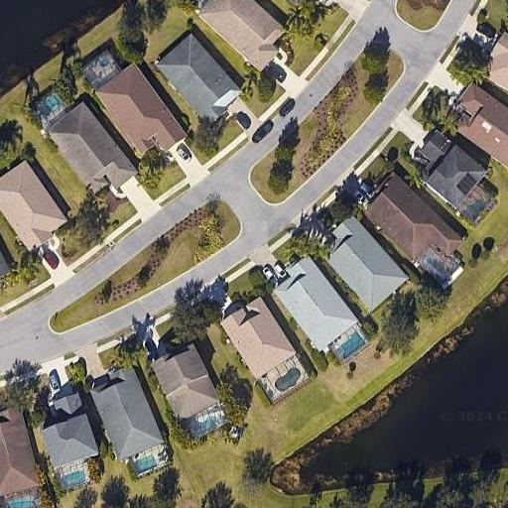
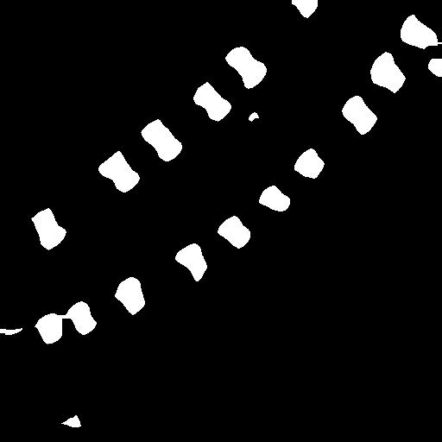
OUTPUT
Input sample
Output mask(eroding with(15x15)kernel

Slide 14
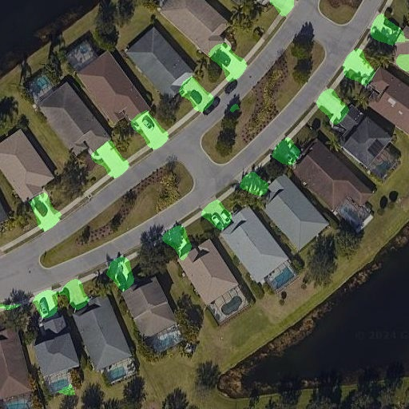
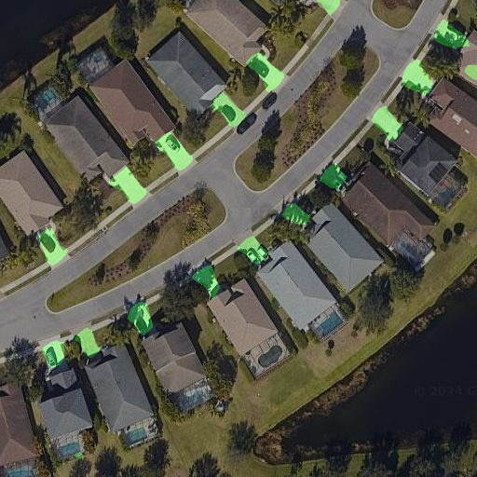
OUTPUT
Overlay-ed image(15x15)
Overlay-ed image(10x10)

Slide 15
REFERENCES
https://idiotdeveloper.com/what-is-unet/
https://www.youtube.com/watch?v=IHq1t7NxS8k
https://wandb.ai/ishandutta/semantic_segmentation_unet/reports/Semantic-Segmentation-with-UNets-in-PyTorch--VmlldzoyMzA3MTk1
https://github.com/milesial/Pytorch-UNet/blob/67bf11b4db4c5f2891bd7e8e7f58bcde8ee2d2db/unet/unet_model.py#L8
https://github.com/uygarkurt/UNet-PyTorch

